Slide 1
Put databases in ALM backgrounds
Alessandro Alpi
@suxstellino
Gian Maria Ricci
@alkampfer

Slide 2











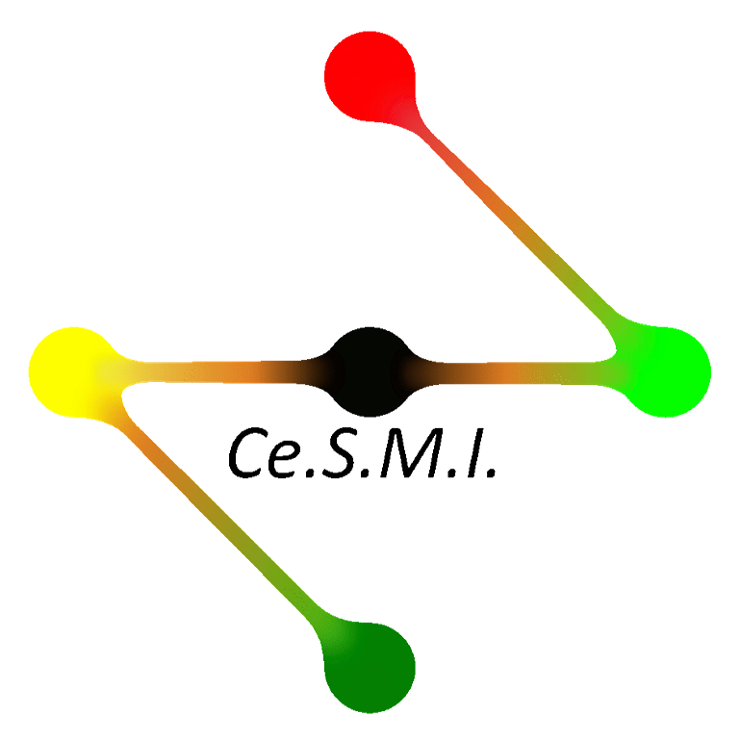



Sponsors & Media Partners

Slide 3

Organizers

Slide 4
About us
Both MVPs (SQL and VS ALM) ☺
Both Microsoft Certified * ☺
blogs:
http://blogs.dotnethell.it/suxstellino
http://www.codewrecks.com/blog/
More details on:
http://www.alessandroalpi.net
http://www.getlatestversion.it/

Slide 5
Agenda
ALM concepts
Source control manager
Database vs Code
Database ALM tools
Development solutions
Testing solutions
Deployment solutions
Conclusions
Q&A

Slide 6
ALM definition
ALM is the product lifecycle management (governance, development, and maintenance) of application software. It encompasses requirements management, software architecture, computer programming, software testing, software maintenance, change management, project management, and release management.
(source Wikipedia)

Slide 7
Why ALM?
Breaking the team barriers (integration)
Release high quality software
Release software in quickly
Customer satisfaction
Improved work organization
Monitoring and tracking the activities
Improved code (clear and easy to read)

Slide 8
Continuous integration
Database integrity check verification
Unit test automation
Code analysis automation
«build» phases

Slide 9
Continous delivery/deployment
Database drifts
Data sync
Deploy pipeline
Integration tests
Automated deploy from a «package»

Slide 10
Task based work
Modifications vs. «reason»
Agile project → BACKLOG
Traditional project → REQUIREMENTS
Tasks developed on iterations (sprints)

Slide 11
ALM and database
The database needs analysis and development
The databases must be redistributed
The databases must be synchronized within the development environment
The database will have «changes» associated to «activities»
The database should be tested
And, of course, it’s a good thing to deploy ☺

Slide 12
Source Control Manager
Management of versions
Changes of the code (and not only those)
Shared entity during development stages,
Deploy and team management
Provides an interface (also graphic)

Slide 13
SCM – Why?
Versions of our code
Safe storage of our files
Share development lines within the team
Creation of a central point for deploying
Automate build and test processes
The real needs of every team..

Slide 14
SCM – Talking about database
DB can be a file «inside the application»
DB is «located on the server»
DB persists user data
DB is not all and only code
However the changes on DB must be reflected on the whole team
The Source Control seems «uncomfortable»

Slide 15
But without a SCM
How can we easily manage the fix?
How can we prevent regressions?
How quickly can we have multiple development environments?
How can we easily create a new dev branch?
How to create different versions of the DB?
How can we synchronize the DB with the latest application changes?

Slide 16
DB vs. code – so different?
The database IS code (programmability, ddl, grant, etc.)
The «domain» tables are like many enums (static data).
The DB should be changed in more development branches.

Slide 17
DB vs. code – so different?
The pointers to the linked servers are configurations (as ‘app.config’)
The login server are environment configurations
The database persist the data. It’s not a *source control* problem

Slide 18
Why put the DB under SCM
Make versions of our objects (DDL) and our programmability on database
Make labels including the database, so we can return to a previous situation
Team synchronized to the get of the version (usually the latest)
To do versioning also of the static data

Slide 19
And more..
Continuous Integration (tests)
Branch (more development lines)
Isolated environments for geographically located teams
Atomicity between application and DB
Saving documentation of the DB

Slide 20
SCM – Here are some
TFS (on-premises and VSOnline)
Git
Mercurial
Subversion
CVS
Perforce
…

Slide 21
Possible actions with SCM
Some actions are:
Get
Commit/Checkin
Undo
Save (working folder)
Delete (working folder)
Edit (working folder)

Slide 22
Management Tool for SCM - DB
Visual Studio
Database projects
Red-Gate Source Control
SQL Test (for CI)
ApexSQL Versions
…

Slide 23
The Team Explorer
Regardless of the tool we use, Team Exploder allows us to:
Improve management of the changesets
Improve association of changesets to tasks
Improve control on commit and checkin phases
Centralize management of checkin policy
Single point for management of the team project

Slide 24
Solutions and tools – development/change
Management Studio – not enough
Visual Studio + database projects
Third party add-ons with SSMS (i.e. Red-Gate SQL Source Control)
Third party stand-alone tools

Slide 25
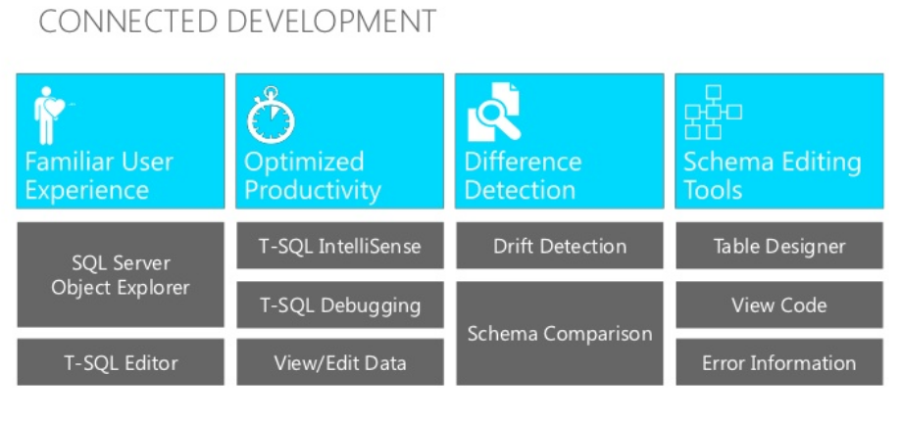
Visual Studio + Database projects
Connected database development

Slide 26
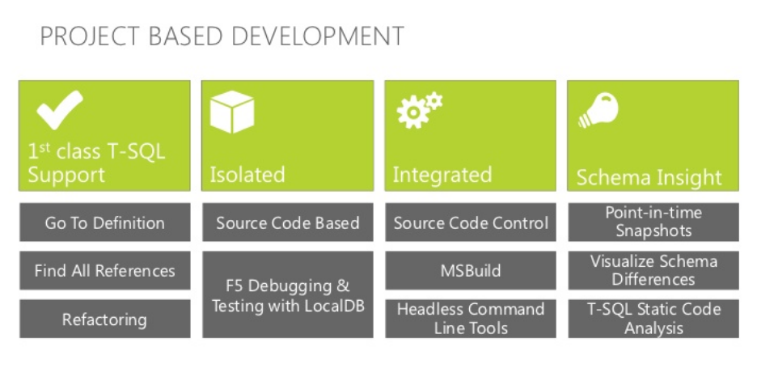
Visual Studio + Database projects
Project based development

Slide 27
DEMO
VSOnline connection
Visual Studio Database Project intro
Project template
Connections
Development
Refactor
Checkin/Checkout
Changeset management

Slide 28
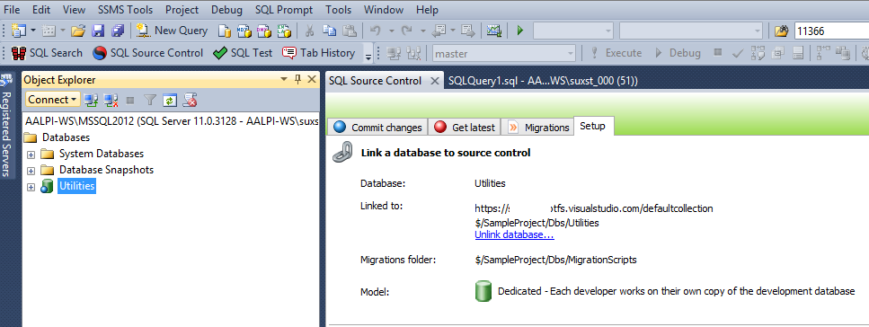
Red-Gate SQL Source Control
Integration with SQL Server Management Studio

Slide 29
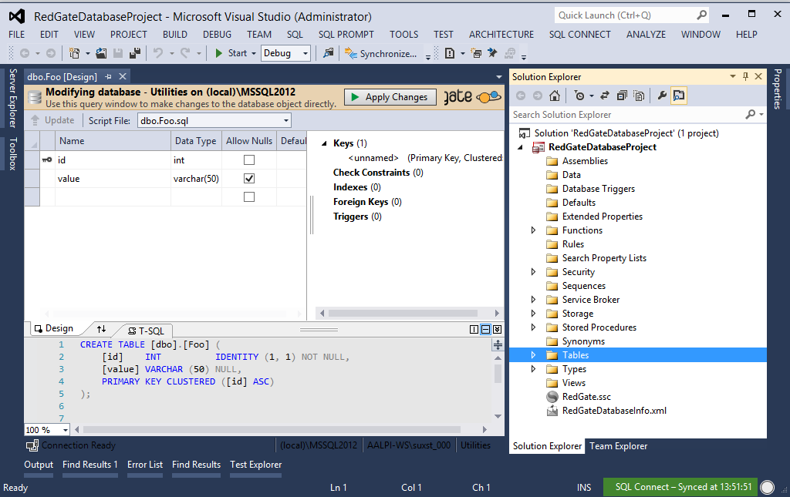
Red-Gate SQL Source Control
Integration with Visual Studio (SQLConnect)

Slide 30
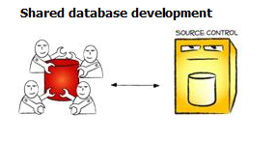
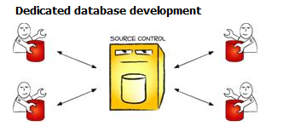
Red-Gate SQL Source Control
Shared development model
Dedicated development model (recommended)

Slide 31
DEMO
VSOnline connection
Intro to Red-Gate SQL Source Control
SSMS Integration
Development type
SCM
Working folder
SCM direct connection
Static data
Checkin/Save
Changeset management

Slide 32
Soluzioni e tool – Unit testing
Visual Studio
Database sandbox
Database unit testing
Backdoor manipulation
Red-Gate SQL Source Control
Framework tSQLt
SQLTest plugin
Integrated with SSMS
Builtin test classes
Naming conventions

Slide 33
DEMO
Unit testing:
Visual Studio
Red-Gate SQL Source Control

Slide 34
Soluzioni e tool – Deployment
Visual Studio Data compare
Live database
Snapshot
Database project
Deploy da:
Data compare
Publish
F5
Data with post build script

Slide 35
Soluzioni e tool – Deployment
Red-Gate SQL Compare and Data Compare
Live database
Working folder
Backup
Integrated with SSMS
Migration scripts
Compare Projects customization
Two kind of projects for Data and Structures (DDL)
Deploy from:
Compare project (DDL)
Compare project (Data)
Script folder
Nuget

Slide 36
DEMO
Deployment:
Visual Studio
Red-Gate SQL Source Control

Slide 37
Conclusions
Which tools to use?
Every tool has its own peculiarity
SQL Source Control allows us to manage data in the easiest way
Visual Studio ensures the same structure of the database project
Visual Studio is more simple for the developers (or SQL Connect)
Which parameters should we consider?
How is our team structured?
Which are the minimum requirements?
How much can I afford to spend?
Can I afford the learning curve if I change IDE?
Last but not least, I should use the Source Control ☺

Slide 38
Resources
http://www.getlatestversion.it/ (ALM italian community)
http://www.getlatestversion.it/2013/11/28/la-difficile-arte-della-stima/
http://www.codewrecks.com/blog/ (Gian Maria Ricci’s blog on ALM)
http://mattvsts.blogspot.it/ (Matteo Emili’s blog on ALM)
http://www.codinghorror.com/blog/2006/12/is-your-database-under-version-control.html
http://odetocode.com/blogs/scott/archive/2008/01/30/three-rules-for-database-work.aspx
http://odetocode.com/blogs/scott/archive/2008/01/31/versioning-databases-the-baseline.aspx
http://odetocode.com/blogs/scott/archive/2008/02/02/versioning-databases-change-scripts.aspx
http://odetocode.com/blogs/scott/archive/2008/02/02/versioning-databases-views-stored-procedures-and-the-like.aspx
http://odetocode.com/blogs/scott/archive/2008/02/03/versioning-databases-branching-and-merging.aspx
http://www.red-gate.com/products/sql-development/sql-source-control/
http://vsaralmassessment.codeplex.com
http://it.wikipedia.org/wiki/Application_lifecycle_management

Slide 39
Q&A
Questions?

Slide 40

Thanks!
#sqlsat264

